Slide 1
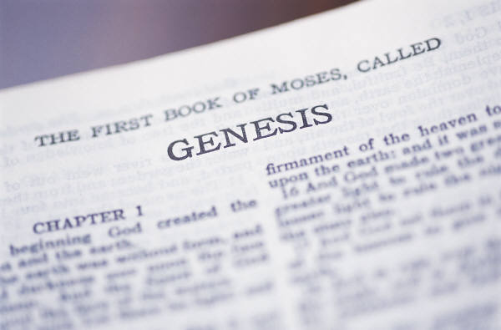
THE DAYS OF GENESIS
Part 1
All verses are from the NKJV unless noted

Slide 2
The days of the creation week
Show that the beginning was “very good” and oppose the reign of chaos and randomness associated with evolutionary doctrine (Gen. 1:31)
Display the power of God (Ps. 33:9)
Affirm the fixity of kinds (Gen. 1:11, 21, 24)
Deny racism showing that all men are from one race—Adam’s (Gen. 3:20; Acts 17:26)
Define man’s sole compatible companion exists in woman (Gen. 2:18)
Explain mankind’s superiority to all other life forms—made in the image of God (Gen. 1:26, 27)

Slide 3

Biblical Chronology
Cannot be reconciled with the secularist’s timetables!
Millions of Years
Day 1 | Day 2 | Day 3 | Day 4 | Day 5 | Day 6 | Day 7
Light | Division of waters | Dry land, grass, herb, fruit | Sun, moon, stars | Sea and air creatures | Land creatures, man, woman | Rest
Earth older than sun
Vegetation older than the sun
Fruit older than pollination from insects
Birds older than land creatures

Slide 4
Genesis
Has been under attack by the secularist and “Christian” alike
  As a book that deals with origins , it provides our framework for knowledge, purpose and work
  “If the foundations are destroyed, what can the righteous do?” (Ps. 11:3)
Is tied to most of the doctrine in the New Testament
Notes:
Last Point: Tied to the doctrine in NT (marriage, life, nature of man, existence of Satan, immodesty and morality, nature of God, second coming of Christ, the definition of sin, baptism, etc.)

Slide 5

Pressing TIME
In Genesis 1
Many fantastic “time buying” opinions have been published and inserted into Genesis 1
  Day-age
  Non-consecutive day-age
  Revelation day-age
  Gap
All of these were designed to cram time into Genesis 1
None of these were formulated from the sacred text
  All have been created to modify the scriptures with secular science
Notes:
“Those who follow the long day interpretation of the days of Genesis 1 are forced to believe in unrevealed miracles to avoid believing in the miracles of creation!” (Mike Willis, The Chronology of the Bible, part 4)

Slide 6

Despite the Importance of Genesis
Book of God
Some in the church have tampered with its doctrine and have sown seeds of confusion and strife
  Where the children of God are to tremble at His enduring word, some seek to rewrite scripture by their “interpretations”
  (Is. 66:2; Dan. 10:11)
  No longer speak “as the oracles of God” (1 Pet. 4:11)
“It Is Written”
Books of man’s wisdom
“It is rewritten,
and rewritten…”
Notes:
Isaiah 66:2, “ ‘For all those things My hand has made, And all those things exist,’ Says the LORD. ‘But on this one will I look: On him who is poor and of a contrite spirit, And who trembles at My word.’ ”
Daniel 10:11, “And he said to me, ‘O Daniel, man greatly beloved, understand the words that I speak to you, and stand upright, for I have now been sent to you.’ While he was speaking this word to me, I stood trembling.”

Slide 7

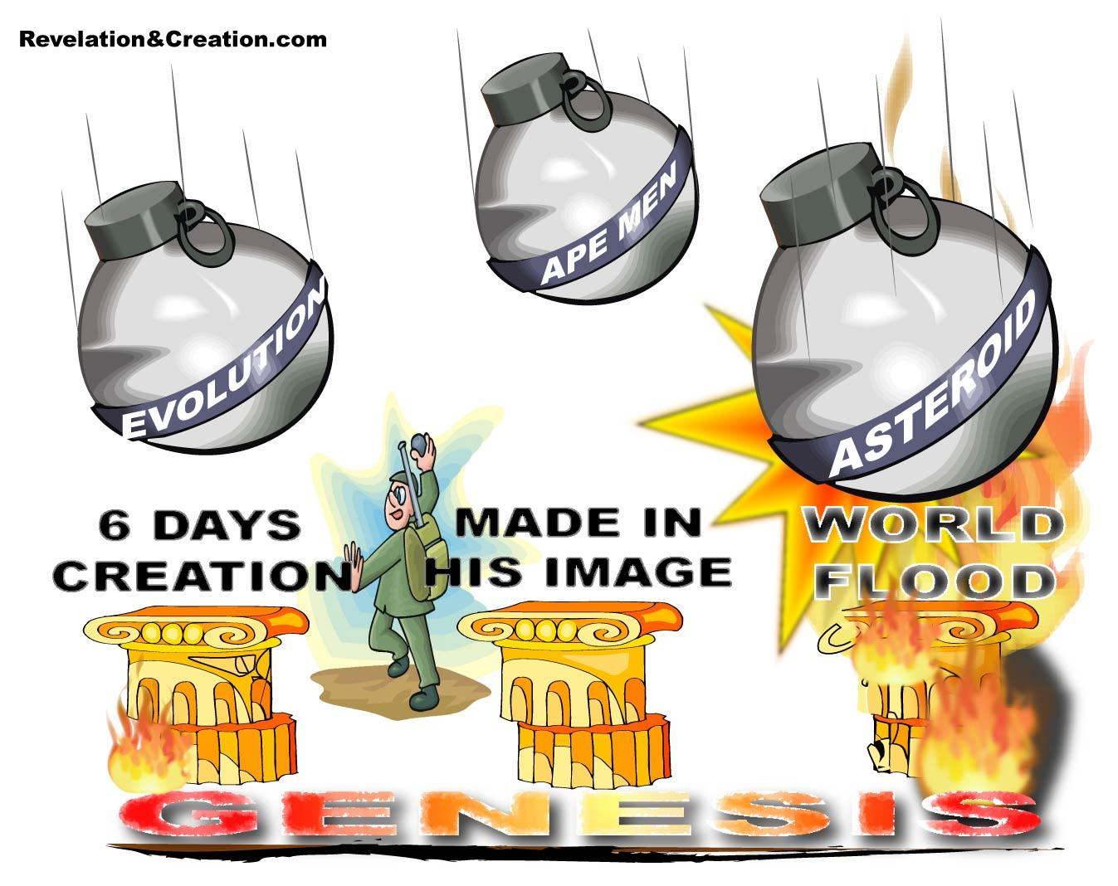

Slide 8
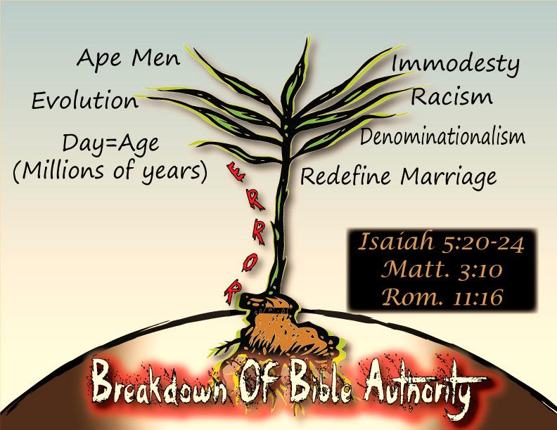
  At its “root” form—the breakdown of Bible authority
Notes:
The challenge that Satan has filled men’s hearts with throughout the ages revolves around skepticism in God’s word (Gen. 3:1-5). Is God’s word trustworthy or not? That is the centerfold of the controversy first introduced by Satan in paradise and continues to pressed upon every generation of people since. Many are ready to abandon the word of God for the word of fallible man.
Luke 6:43, “For a good tree does not bear bad fruit, nor does a bad tree bear good fruit.”
Bible authority opposes all these things so from the root-ball of questioning and challenging bible authority springs the tree of knowledge that is away from God.

Slide 9
In This Series
We will expose false claims asserted by some regarding the Genesis record
Debunk false claims regarding Noah’s flood and the days of Genesis
Identify the fruit of this error
Identify the proper approach to scripture
Provide 5 reasons why the days of Genesis MUST be literal days

Slide 10
Proverbs 30:5, 6
Every word of God is pure; He is a shield to those who put their trust in Him.
Do not add to His words, Lest He rebuke you, and you be found a liar.

Slide 11
THE PLAN FOR
YOUR SALVATION
Hear the Word of God---Rom. 10:17
Believing In Your Heart---Heb. 11:6
Repenting Of Your Sins---Acts 2:38
Confess That Christ Is The Son of God--- Rom. 10:10; Acts 8:37
Be Baptized Into Christ---Gal. 3:26-29
Be Faithful Until Death---Rev. 2:10; I Cor. 15:58

